Slide 1
Emotion Recognition
AKITI SRI KALYAN REDDY
19STUCHH010130

Slide 2

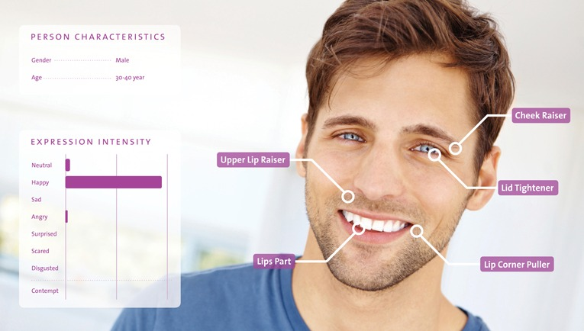
Introduction
In our daily lives, we encounter various situations and emotions. An emotion is a strong feeling about a human situation.These emotions and thoughts are expressed through facial expressions and for detecting those emotions we will be using Emotion recognition.It is a technique that uses advanced image processing to read the emotions on a human face where, it detect emotions of different format from the given data.

Slide 3
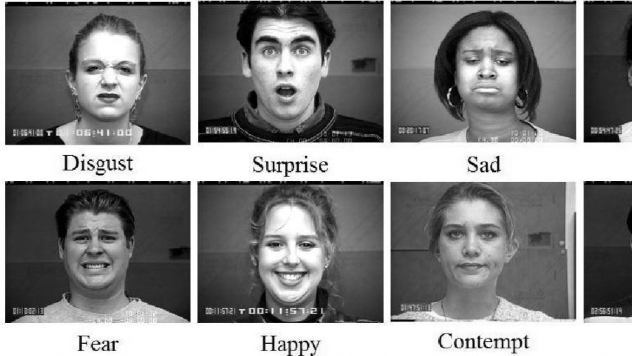
People display a variety of emotions, anger,sadness, disgust, fear, happiness, and surprise. By utilising all these qualities, we may achieve advancements in a number of different areas. I'm motivated to work on this project to contribute to this field and enhance improvements in the below application's.
Application of emotion detection in real life:
1)retail: advertising/marketing
2)Health sector: hospitals and healthcare
3)Education: eye tracking to information of students
4)SenseCrowd: for doing experiments in physical environment

Slide 4
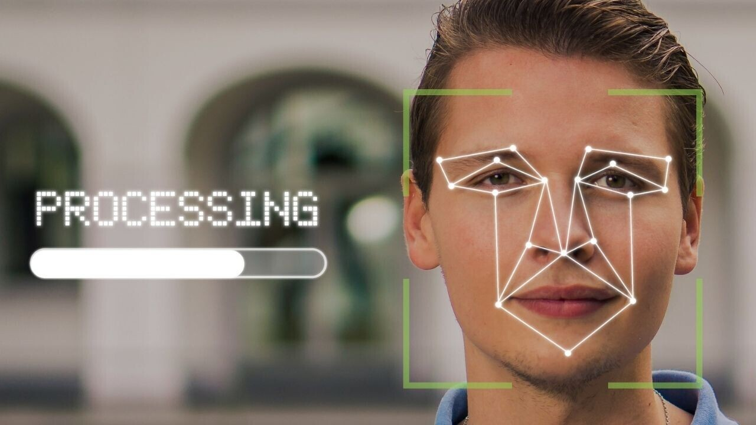
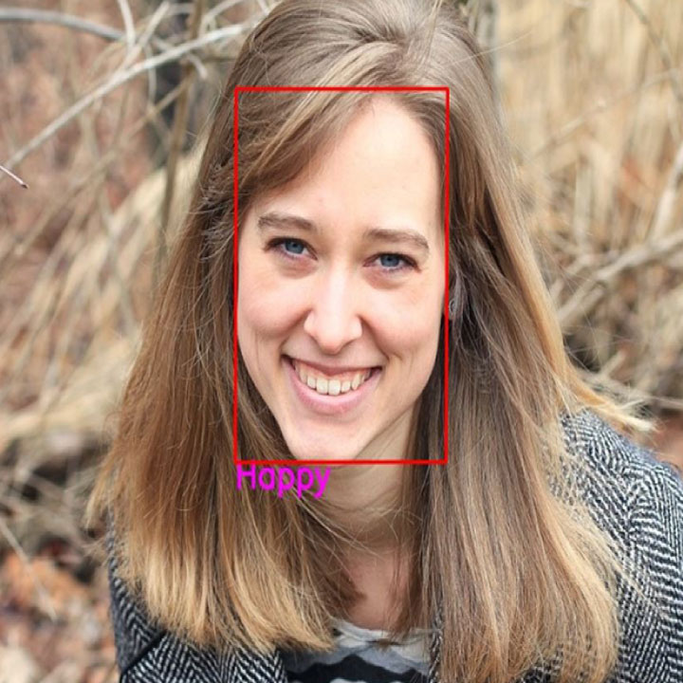
In this research, we describe a dilated convolution-based approach to learning about convolutional neural networks. Where we'll build a deep network to identify facial emotions where, we will collect the data that has been broken down into various classes and label it in a sequential manner and use it for building a model. There are numerous emotions that a human can experience in facial emotion detection. Therefore, we will concentrate on a few courses and train a model that can detect face emotion. The machine learning model will then attempt to differentiate between various inputs before producing results. It will use facial recognition to find human faces and artificial intelligence techniques like neural networks to analyse human emotions.

Slide 5
Approach of Facial Emotion Detection Using CNN
Collection of data
Image enhancement
Train and build a model
Detection using the webcam

Slide 6
THANK YOU

